Slide 1
Classification of Music by Genre
Classical Machine Learning versus Neural Networks on GTZAN
Brian Miller
TECH 27 — Machine Learning with Python — Summer 2026
September 10, 2026
Notes:
Introduce the project: ten models, one dataset, one fixed test set.

Slide 2
Objective and Motivation
• Classify 30-second music clips into 10 genres
– blues, classical, country, disco, hip-hop, jazz, metal, pop, reggae, rock
• Compare classical ML against neural networks on identical test songs
• Ask: does more model capacity help on a small dataset?
• Motivation:
This problem is of interest to me because I am a music fan, and interested in how computers can recommend music that is new to me and similar to other music I am already familiar with. One way is to limit by genre and recommend more in the same genres that I tend to prefer. In addition to recommendations, it can also be helpful for automated tagging of digital audio files in a collection, and to assist in searching when a listener desires to hear music from a particular genre(s) or to exclude others.
Music Genre Classification — Brian Miller — TECH 27, Summer 2026
Notes:
Motivation is personal — fill in why you chose this problem.

Slide 3
Dataset: GTZAN
• 1,000 thirty-second clips — 100 per genre — perfectly balanced
• Two representations of each clip:
– 58 pre-extracted audio features (MFCC, chroma, spectral, rhythm)
– a mel-spectrogram image (999 available — one jazz clip missing)
• Stratified song-level split: 800 training / 200 test songs (20 per genre)
– the identical 200 test songs are used for all ten models
• Neural networks: further 639 / 160 train / validation split for tuning
Music Genre Classification — Brian Miller — TECH 27, Summer 2026
Notes:
One dataset, two representations, one fixed song-level split shared by every model.

Slide 4
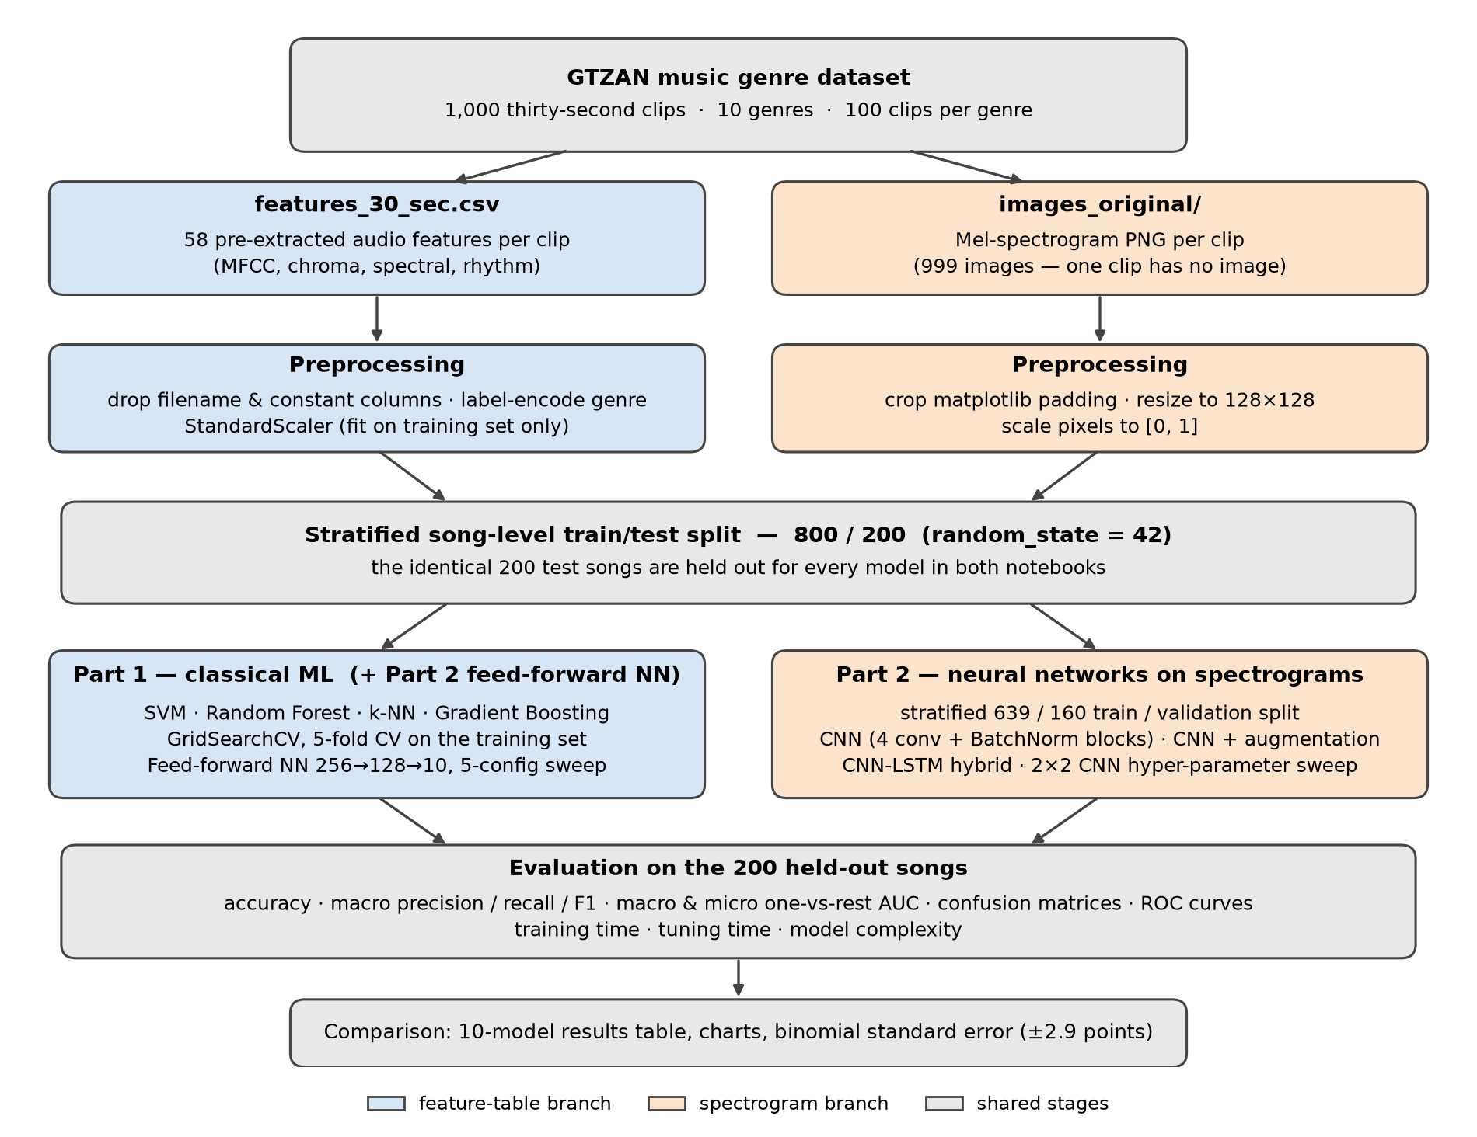
Project Pipeline
Music Genre Classification — Brian Miller — TECH 27, Summer 2026
Notes:
Blue = feature-table branch, orange = spectrogram branch, grey = shared stages.

Slide 5
Ten Models, Two Families
Family | Model | Input
Classical ML | SVM · Random Forest · k-NN · Gradient Boosting (each tuned by grid search) | 58 features
Neural network | Feed-forward NN (baseline and tuned) | 58 features
Neural network | CNN · CNN + augmentation (two versions) | 128×128 spectrogram
Neural network | CNN-LSTM (conv blocks + bidirectional LSTM) | 128×128 spectrogram
Music Genre Classification — Brian Miller — TECH 27, Summer 2026
Notes:
Four classical algorithms span margin-based, bagged, instance-based and boosted methods.

Slide 6
Evaluation Metrics and Success Criteria
• Accuracy, macro precision, recall and F1 — every genre weighted equally
• Confusion matrices and one-vs-rest ROC curves; macro and micro AUC
• Training time, tuning time and model complexity
• Success: at least one model with >= 80% test accuracy
• Failure: all models are below 50% test accuracy
• Caution: 200 test songs → standard error ≈ 2.9 points, 95% margin ≈ ±5.3
Music Genre Classification — Brian Miller — TECH 27, Summer 2026
Notes:
Balanced classes make accuracy meaningful; AUC shows ranking quality beyond the top prediction.

Slide 7
Part 1: Tuning the Classical Models
Model | Default | Tuned | Macro AUC | Tuning time
SVM | 0.735 | 0.765 | 0.944 | 11.9 s
Random Forest | 0.775 | 0.820 | 0.975 | 106.9 s
k-NN | 0.675 | 0.690 | 0.905 | 0.4 s
Gradient Boosting | 0.780 | 0.795 | 0.978 | 3,234.8 s
Random Forest and Gradient Boosting both reach 0.9988 training accuracy — generalization gaps of 0.18 and 0.20
Music Genre Classification — Brian Miller — TECH 27, Summer 2026
Notes:
Tuning raised every accuracy; Random Forest gained the most.

Slide 8
Part 2: Neural Networks
• Feed-forward NN: 0.775 in under 5 s — tuning re-selected the baseline, then scored 0.755
• CNN on spectrograms: 0.785 — best neural model, but 0.998 training accuracy
• CNN tuning (2×2 grid): again re-selected the hand-chosen configuration
• Augmentation: slowed memorization, did not raise test accuracy (0.760 / 0.740)
– the two augmentation variants swapped order across three runs — noise
• CNN-LSTM: 0.700 — largest model (653k parameters), weakest neural result
Music Genre Classification — Brian Miller — TECH 27, Summer 2026
Notes:
Every attempt to improve the CNN failed to beat simpler baselines.

Slide 9
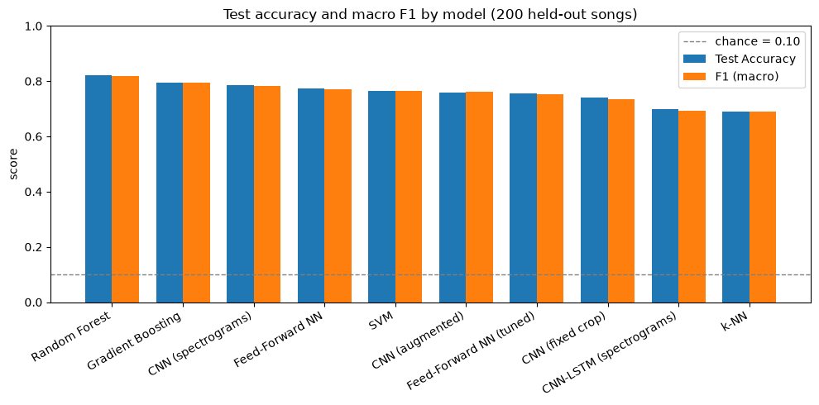
All Ten Models Compared
Test accuracy and macro F1 on the 200 held-out songs (dashed line = chance)
Music Genre Classification — Brian Miller — TECH 27, Summer 2026
Notes:
The top five span only 11 songs.

Slide 10
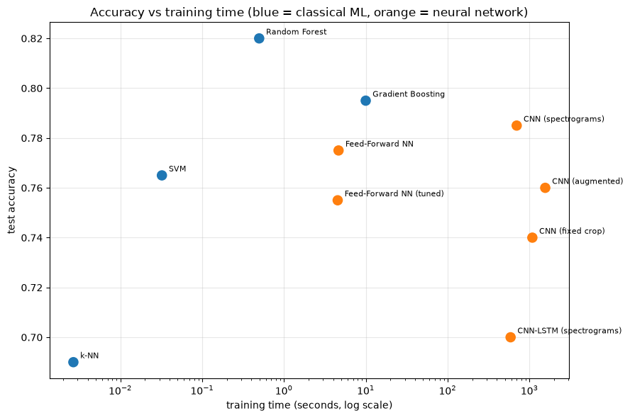
Accuracy versus Training Cost
Random Forest: 0.820 in 0.5 s. CNN: 0.785 in 697 s.
Music Genre Classification — Brian Miller — TECH 27, Summer 2026
Notes:
Log scale — the CNN took over 1,000× Random Forest's training time.

Slide 11
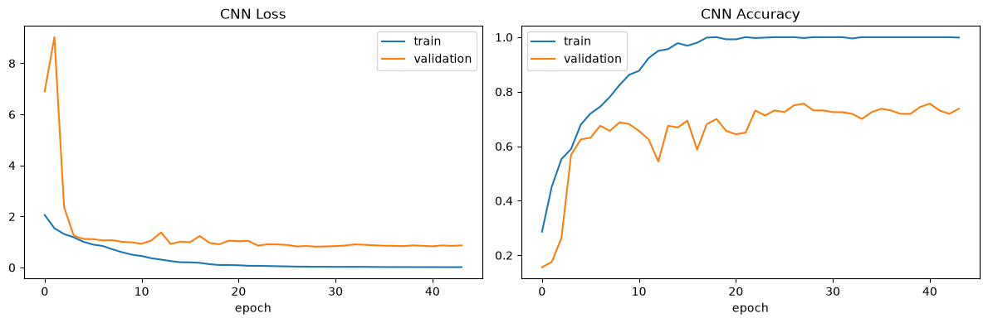
The CNN Memorizes
Baseline CNN learning curves — a 21-point generalization gap on the test set
Music Genre Classification — Brian Miller — TECH 27, Summer 2026
Notes:
Training accuracy ~1.00 by epoch 18; validation plateaus near 0.74.

Slide 12
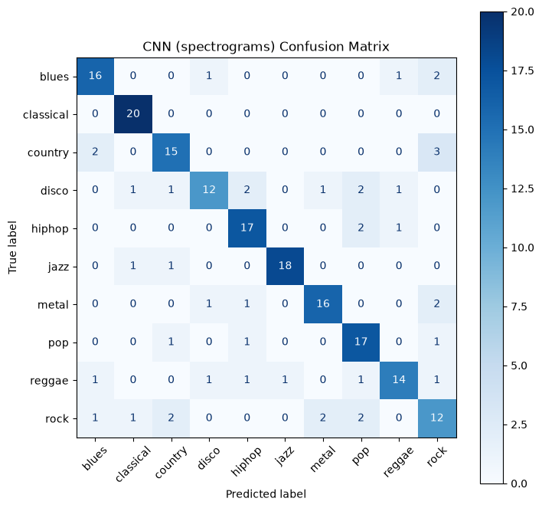
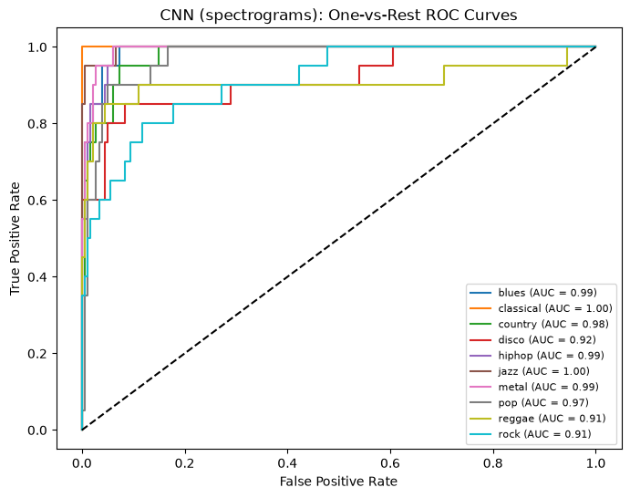
Where the Models Fail
Baseline CNN: classical identified perfectly; rock and disco weakest
Music Genre Classification — Brian Miller — TECH 27, Summer 2026
Notes:
Rock: recall 0.60 but AUC 0.91 — ranked plausibly, rarely picked first. Also over-predicted: 21 predictions, 12 correct.

Slide 13
Key Findings
• Best model: tuned Random Forest — 0.820 accuracy in half a second
• Most of the ranking is sampling noise (±5.3-point margin)
– only k-NN and CNN-LSTM are clearly worse than the leader
• More capacity did not help — the largest model was the weakest neural network
• Tuning, augmentation and architecture all failed to move the result
• Per-genre pattern is stable: classical easy; rock hard and over-predicted
Music Genre Classification — Brian Miller — TECH 27, Summer 2026
Notes:
Main takeaway: data volume, not model capacity, is the binding constraint.

Slide 14
Challenges and How They Were Solved
• CNN behaved like a random classifier → batch-norm momentum 0.99 too slow for ~20 updates/epoch; set to 0.9
• Keras validation_split took only the last genre → explicit stratified split
• Augmentation silently replayed identical images every epoch → diagnosed with iterator tests, fixed with a seeded generator
• Augmented runs not reproducible → measured the variation across three runs and reported it
• Stale notebook state → clean restart-and-run-all; every number re-verified
• A plausible 'disco magnet' hypothesis did not reproduce → withdrawn
Music Genre Classification — Brian Miller — TECH 27, Summer 2026
Notes:
Each challenge was found by a targeted diagnostic test in the notebook.

Slide 15
Ethics and Bias
• Genre labels are subjective and culturally constructed
• One small dataset can't cover the world's music — ten Western popular genres, c. 2000
• Performers' gender, race, country, language, wealth and more are not recorded — the dataset can't even be audited for these biases
• Recent Western, English-language music dominates online catalogues; music from lower-income countries and the Global South is under-represented
• Model bias: the CNN over-predicts rock — a recommender would push other genres' songs into rock
• There could be repeated and mislabelled clips in GTZAN [mentioned in Sturm 2013]
• Leaky evaluation (segments of one song in train and test) overstates accuracy — >90% reported elsewhere
• Commercially released music has issues regarding copyright and licensing. Other music for possible training use in the future needs to be chosen carefully so as not to risk concerns of stealing artist works by professional musicians who would prefer that their music not be used for training AI systems.
Music Genre Classification — Brian Miller — TECH 27, Summer 2026
Notes:
Draft — review against course discussion. Key point: GTZAN records nothing about performers, so representation bias cannot even be measured; and the music that is easiest to collect online is disproportionately recent, Western and English-language.

Slide 16
Conclusion and Future Work
• Simple, fast models matched or beat the neural networks on this dataset
• Findings agree with published work (Akhtar & Mishra, arXiv 2025)
• Future work:
– 3-second segment features with a song-level split (10× more rows)
– transfer learning from a pretrained network
– soft-voting ensembles of existing models
– repeated / cross-validated evaluation for confidence intervals
Music Genre Classification — Brian Miller — TECH 27, Summer 2026
Notes:
Consistent with Akhtar & Mishra (2025): engineered features beat a CNN on GTZAN.

Slide 17
Questions?
Brian Miller — Music Genre Classification

